Slide 1
Phonics and Early Reading at Yerbury
Tuesday 1st October 2024

Slide 2
What are we going to cover?
What is Phonics?
How we teach phonics – lesson example
Progression in phonics
Supporting your child with reading at home
Supporting your child with writing at home
FAQs

Slide 3
What is Phonics?
A method of teaching beginners to read and pronounce words by learning to associate letters or letter groups with the sounds they represent.
There are 44 main sounds in the English Language. Each sound is represented by a grapheme (the written representation of a sound).

Slide 4
Change to Phonics Programmes
In April 2021, all schools had to choose a phonics teaching programme that had recently be validated by the government. This was to ensure consistent teaching of phonics throughout the country.
Our phonics leads chose ELS
‘Getting all children to read well, quickly.’

Slide 5
Phonics Glossary
Phoneme: the smallest single identifiable sound in a word.
For example, in the word 'cat' there are three phonemes c/a/t.
Grapheme: the written representation of a sound.
Digraph: two letters making one sound. For example, /sh/ in the word 'shop'.
Trigraph: three letters making one sound. For example, /igh/ in the word 'night'.
Split digraph: two vowel letters split but are split by one or more consonants. For example, /a-e/ in the word 'cake'.

Slide 6
How do we teach phonics?
We teach phonics every single day from the first days of Reception.
The children will experience the same classroom routines within each lesson.
In every lesson, your child will make the direct application to reading.
We have mnemonics and rhymes to support learning and recall.
Lots of opportunities for oral blending- /c/ /oa/ /t/ .
Lesson ‘I’

Slide 7
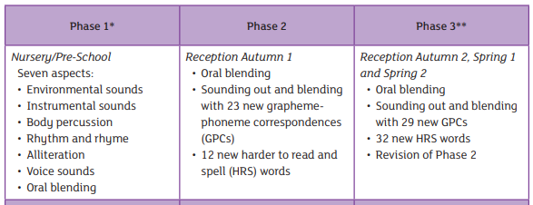
Progression

Slide 8
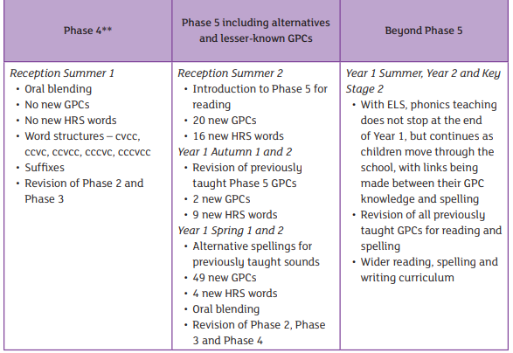
Progression

Slide 9
Supporting your child with reading at home
Read a bedtime story every night – a book from home, the library or story book from school.
PACT scheme – what will be in your child’s bag.
Read in the language that you are most confident with.
E books that you have access to weekly are entirely decodable - texts are carefully sequenced to progressively incorporate words that are consistent with the letter–sound relationships that have been taught to the new reader.

Slide 10
Pronouncing pure sounds
We must use pure sounds when we are pronouncing the sounds and supporting children in reading words.
c a t not cuh a tuh
If we mispronounce these sounds we will make reading harder for our children.
There are videos for this on our school website where you can hear the correct pronunciation of the sounds.

Slide 11
Supporting your child with writing at home
Say the word Stretch the word out Use robot arms Blend Count the phonemes Say the word
Letter formation is practised daily – lower case letters – starting from the top in most letters.
Help your child by saying the sentence out loud first. This gives you a chance to broaden your child’s vocabulary and it ensures that the sentence makes sense.
Think of everyday ways to introduce writing – shopping lists, notes to jog memory, cards for different occasions, signs whilst playing

Slide 12
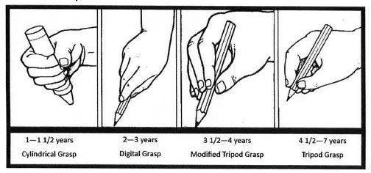
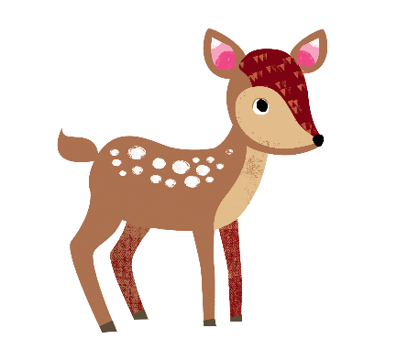
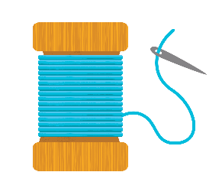
Supporting your child with writing at home
Sitting position – chair tucked in, both feet on floor, not slouching

Slide 13
FAQs
How do I access the weekly e-book?
Every child will be given a login and password at the beginning of the year (it will be stuck into the front of their reading record books in their PACT bags). We choose an e-book on a Friday morning which you can access for a week. These books are fully decodable and contain the sounds that we have learnt that week.
When my child is writing at home and they get a sound wrong or don’t know a sound, should I intervene?
We really want children to be ‘free writers’ and to take pleasure in writing. If your child specifically asks you how to spell a word, help them hear the different sounds in the word and encourage them to ‘have-a-go’ at it independently. Praise them for their effort even if it’s not entirely correct! At school, we do the same when the children are writing independently but if we taught a specific sound, then we will encourage them to write it correctly.
How do you get children of this age to sit and focus during the phonics session?
The sessions are very repetitive and follow the same routines each session. The children get used to this and because they know what is coming next, they remain very focussed. The sessions are also quite interactive – robot arms, drum rolls etc.

